Slide 1
Angular 學習筆記
台中榮民總醫院 資訊室實習

Slide 2
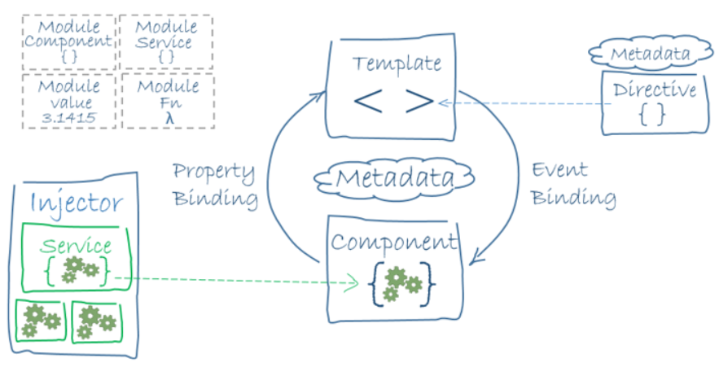
Angular Architecture

Slide 3
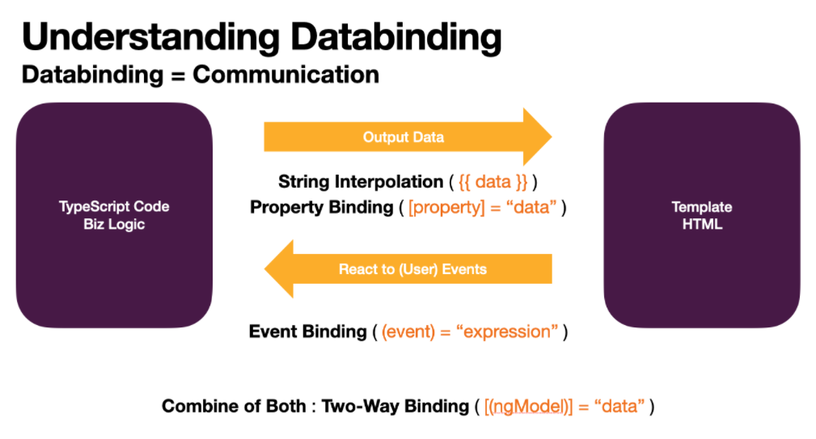
Data Binding
Tips : Property Binding [] + Event Binding ()

Slide 4
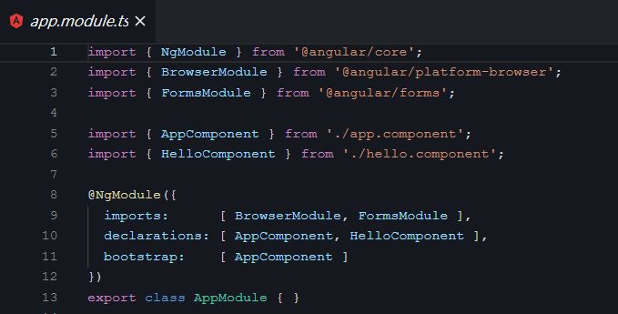
Module
What is Module ?
Angular applications are modular and Angular has its own modularity system called NgModules.
Every Angular application has at least one NgModule class, the root module, which is conventionally named AppModule and resides in a file named app.module.ts. You launch your application by bootstrapping the root NgModule.
Two-way Binding

Slide 5
Directives
What is Directive ?
Provides two types of directives :
Structural directives change the structure of DOM template. For example, *ngFor, *ngSwitch, *ngIf etc
Attribute directive updates the attribute of specific HTML control for example [ngClass]

Slide 6
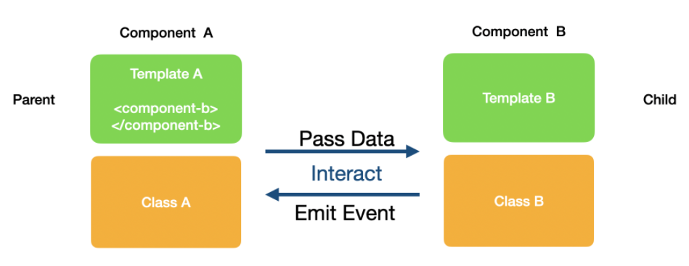
Splitting App Into Components
How Parent & Child Component Interact ?

Slide 7
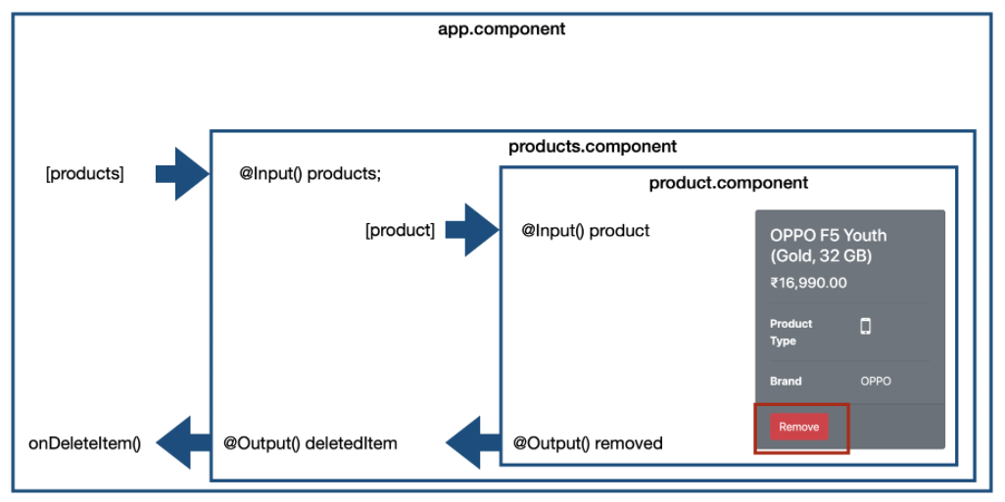
Interaction for each comnponent

Slide 8
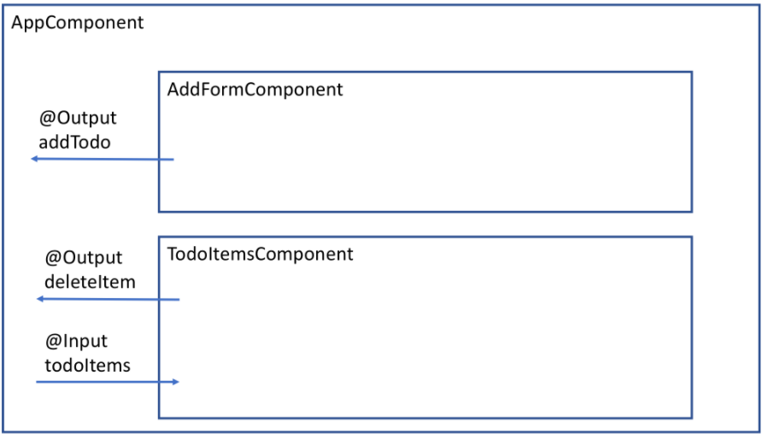
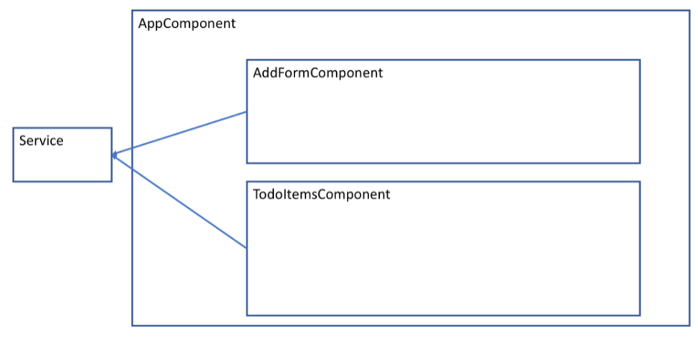
Services
Why would you Need Services ?
Components shouldn't fetch or save data directly and they certainly shouldn't knowingly present fake data. They should focus on presenting data and delegate data access to a service.
→讓架構更明確

Slide 9
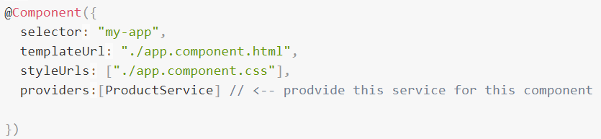
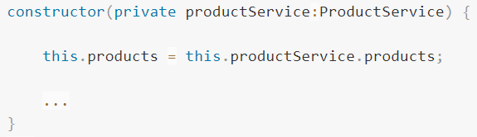
Services
How to use Services ?
Import
Provide
Inject

Slide 10
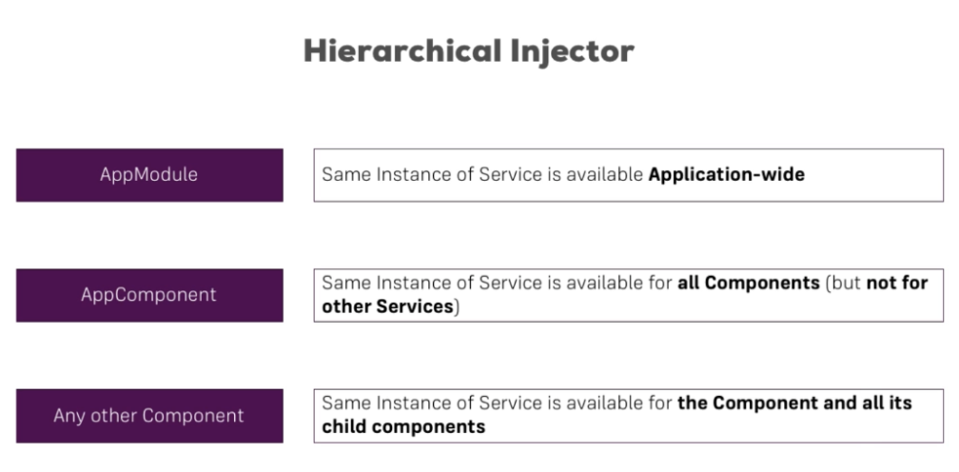
Services
How to use Services ?

Slide 11
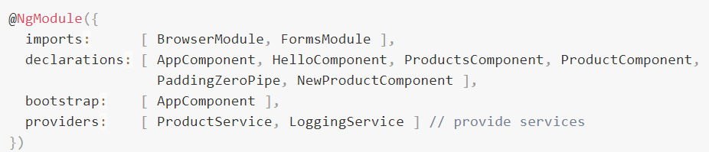
Services
How to use Services ?
Provide Service in AppModule

Slide 12
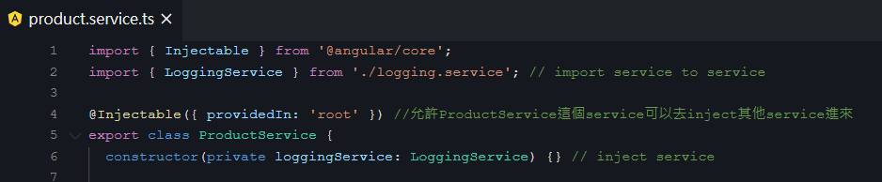
Services
多個 Services ?
Inject Service into Services
把這個service provide給整個app component

Slide 13
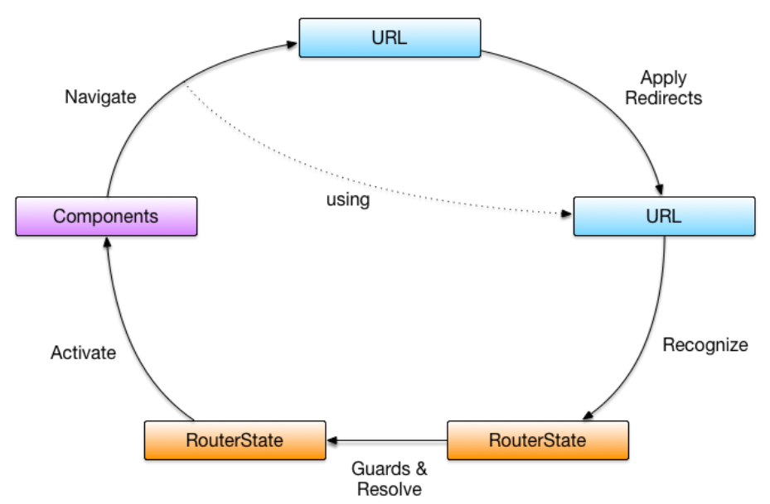
Routing
What is Angular Router and How it Works ?
套用轉址設定 (Applying Redirects)
從 URL 識別路由狀態 (Recognizing States)
從路由狀態解析出路由資訊 (Running Guards & Resolving Data)
依據路由資訊產生元件實體 (Activating Components)
套用導覽動作，從目前狀態移轉至下一個狀態 (Navigation)

Slide 14
Routing
What is Angular Router and How it Works ?

Slide 15
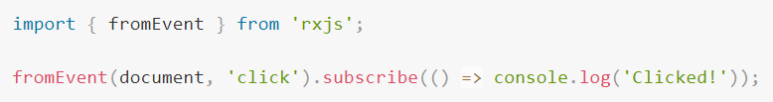
RxJS (Reactive Extensions for JavaScript)
What is RxJS ?
RxJS is a library for composing asynchronous and event-based programs by using observable sequences.
JS：
RxJS：
observable.subscribe() means “give me any amount of values, either synchronously or asynchronously”
fromEvent() means “change a event to be observable”

Slide 16
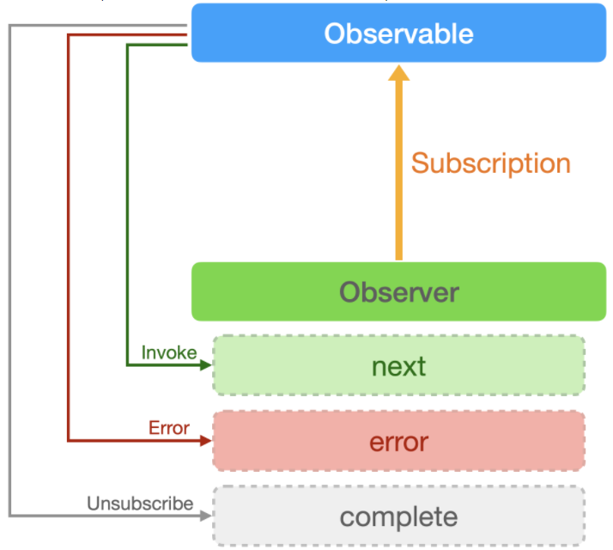
Observable
What is Observable, Observer and Subscription ?
The relationship between Observable, Observer and Subscription

Slide 17
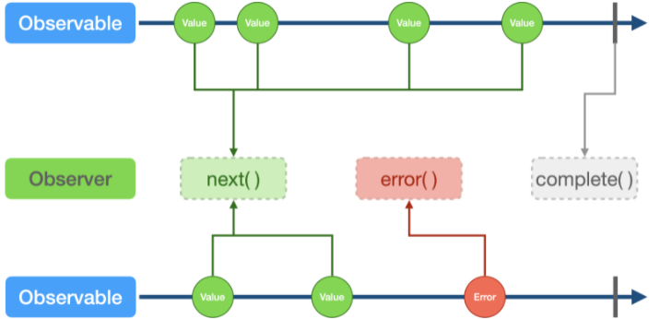
Observable
What is Observable, Observer and Subscription ?
Understanding observable with marble diagram
出現error後，程式就不會再跑了

Slide 18
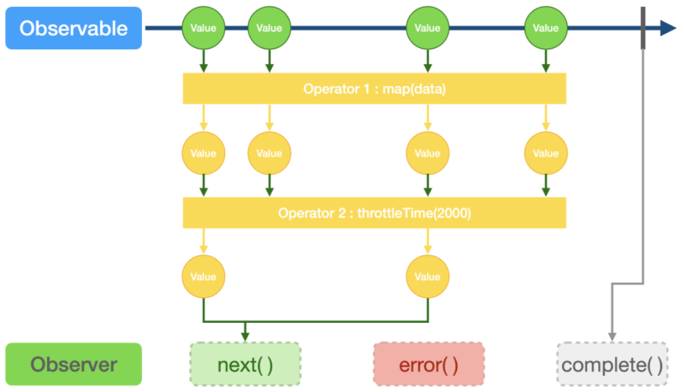
Operators
What are operators?
Operators are functions. There are two kinds of operators：
Pipeable : Can be piped to Observables using Observable.pipe(…)
Creation : Can be called as standalone functions to create a new observable
Ex. filter()、map()…
Ex. from()、of ()、new Observable()…

Slide 19
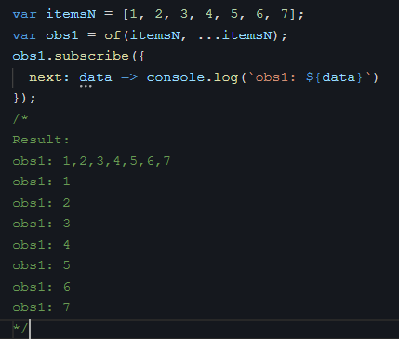
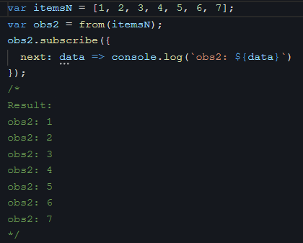
Operators
任何一個object都可以透過of或from變成observable!!!
Creation Operators
of & from
of：
of ()接的是一個一個的參數
from：
from ()接的是一個Array
…是指將一個Array解構
from() 會自動將一個array拆解成一個個的物件

Slide 20
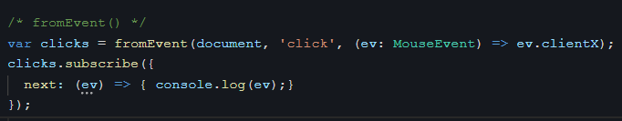
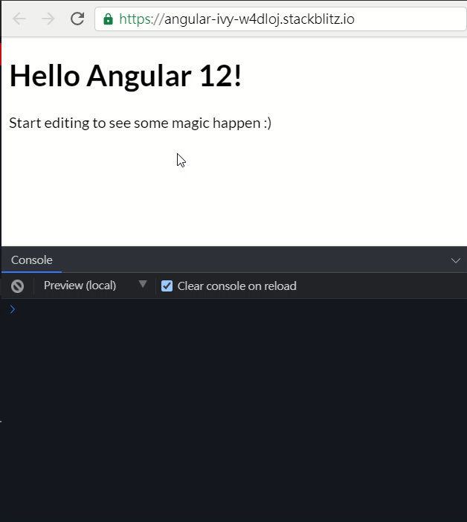
Operators
Creation Operators
Event一定要做型別的宣告，不然會報錯：Property 'clientX' does not exist on type 'Event'.
fromEvent

Slide 21
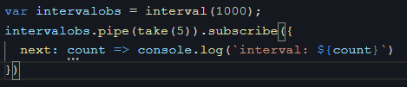
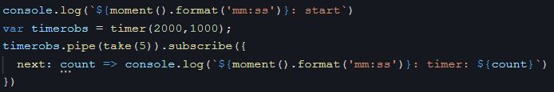
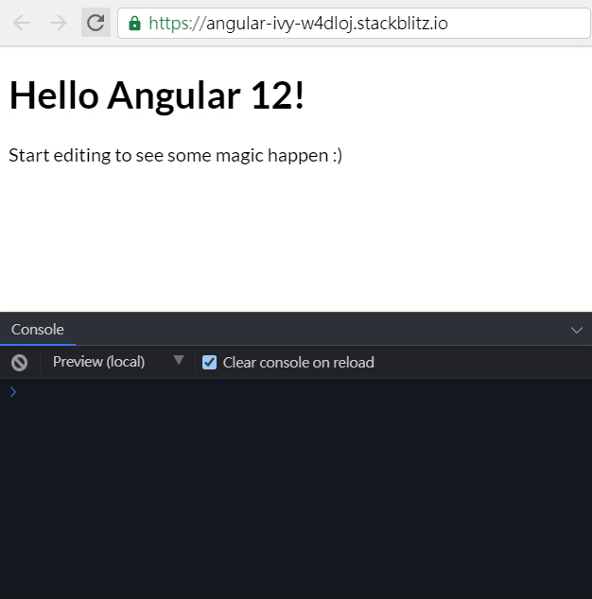
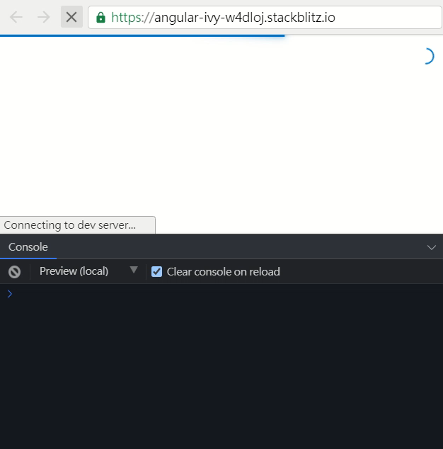
Operators
Creation Operators
timer ( delay + interval)
2s 後開始 interval(1000)
interval & timer
interval：
timer：

Slide 22
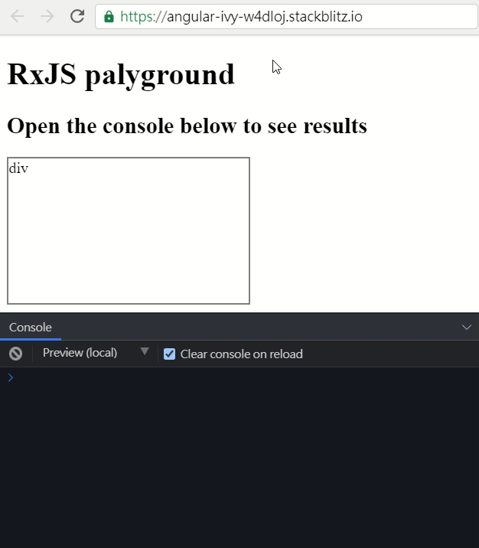
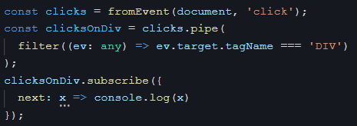
Operators
Filtering Operators
filter

Slide 23
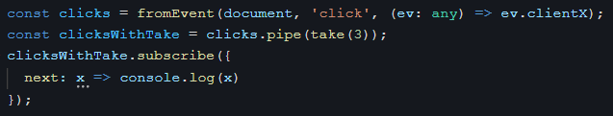
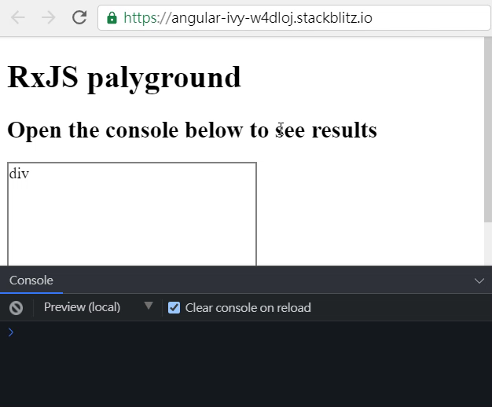
Operators
Filtering Operators
take : 發生幾次後 complte

Slide 24
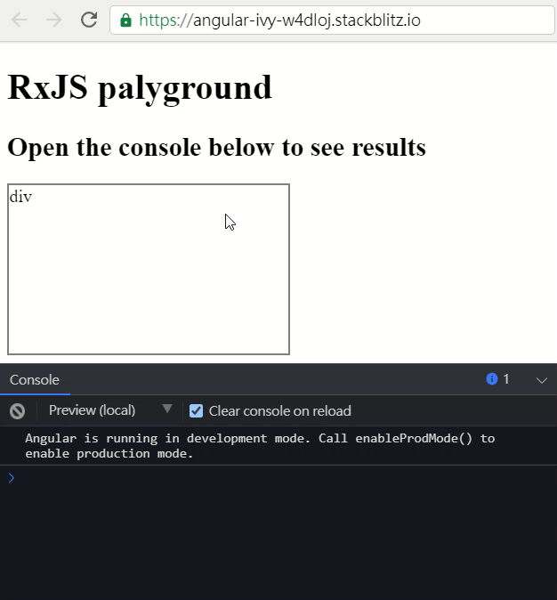
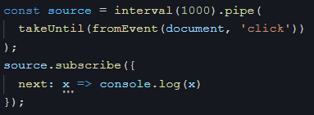
Operators
Filtering Operators
takeUntil : 指定的事件發生時 complte

Slide 25
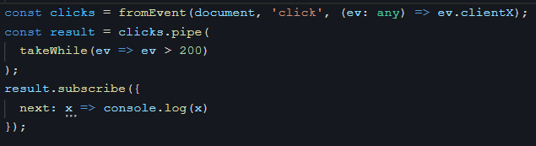
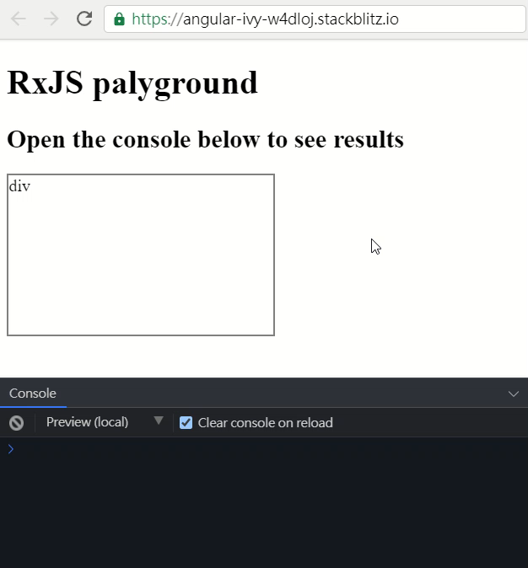
Operators
Filtering Operators
takeWhile : 指定的事件簿成立時 complte，有點類似do{…}while()

Slide 26
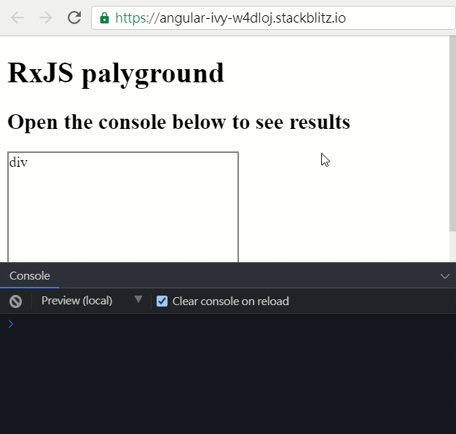
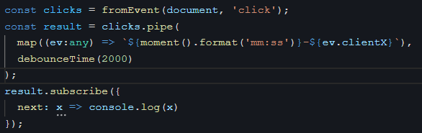
Operators
Filtering Operators
debounceTime : Emit a value from the source Observable only a particular time span has passed without other source emission.
取某段特定時間內，最後一次發生的事件

Slide 27
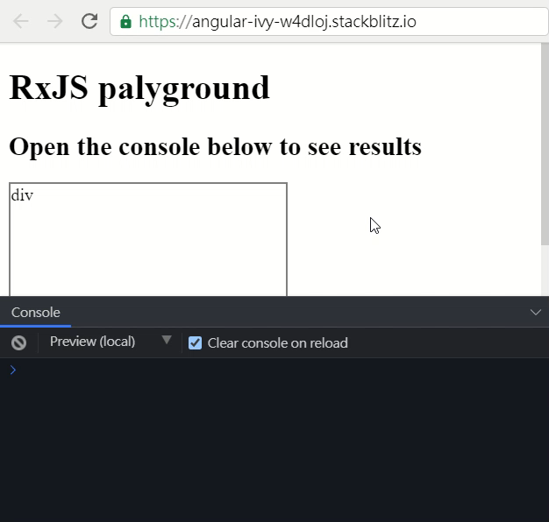
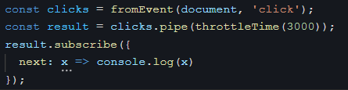
Operators
Filtering Operators
throttleTime : Emit a value from the source Observable, then ignore subsequent source values for [duration milliseconds]
取某段特定時間內，第一次發生的事件

Slide 28
Operators
Join Operators
最常用在兩個以上HTTP要資料的時候
combineLatestWith : 當兩個HTTP都有結果才會吐資料
concat : 兩條線依序執行
merge : 兩條線是平行的(同時進行)，只要有一個HTTP拿到資料就吐出來
forkJoin : 兩個HTTP都有結果才會吐資料，且只會取最後一次的資料
最常使用→因為HTTP取值只會有一次

Slide 29
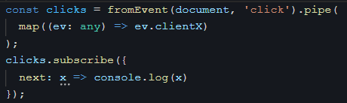
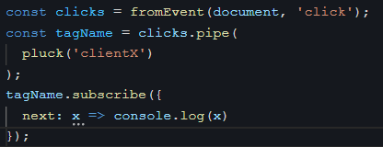
Operators
Transformation Operators
map & pluck & mapTo
map：
pluck：Maps each source value (an object) to its specified nested property.
mapTo：
pluck() 可以抓多層property的value
mapTo() 把每個事件最後結果都指定到某個值

Slide 30
Operators
Transformation Operators
map vs tap vs swichMap
RxJS 提供的 map() operator 跟我們在 JavaScript 使用的 map() 非常類似，不同的是 JavaScript 的 map() 是將一個陣列換成另外一個陣列， 而 RxJS 則是將一個訂閱可以得到的資料轉換成另外一筆資料。
map | tap | swichMap
將原來的資料轉換成另外一個資料 | 不會做認資料的變換，也不會影響整個 RxJS 資料流方向 | 可以在收到 observable 資料時，轉換成另外一個 observable

Slide 31
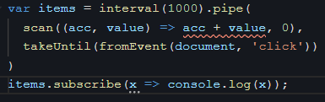
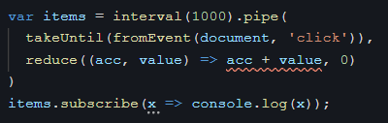
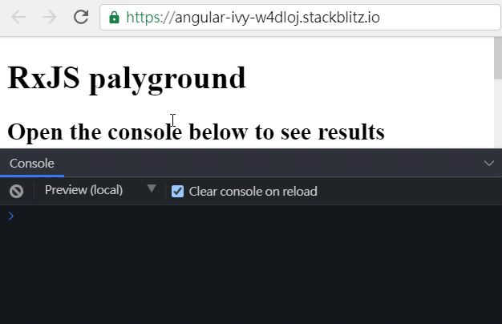

Operators
Mathematical and Aggregate Operators
scan & reduce
scan：
reduce：

Slide 32
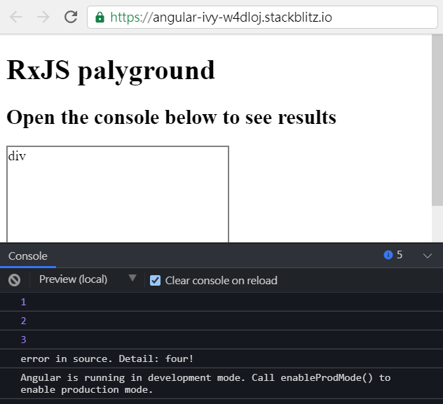
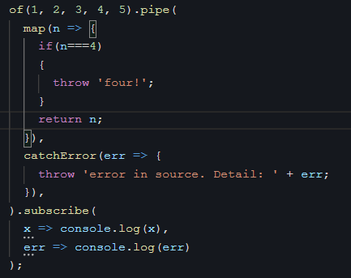
Operators
Error Handling Operators
catchError

Slide 33
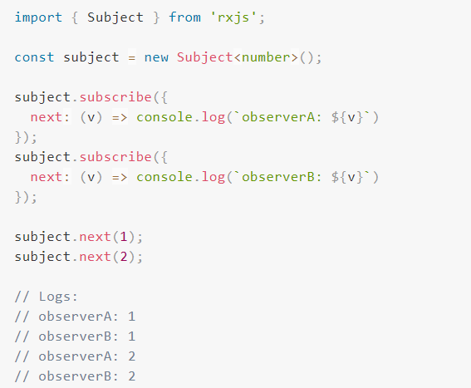
Subject
What is Subject ?
A Subject is like an Observable, but can multicast to many Observers. Subjects are like EventEmitters: they maintain a registry of many listeners.
Every Subject is an Observable.
Every Subject is an Observer.

Slide 34
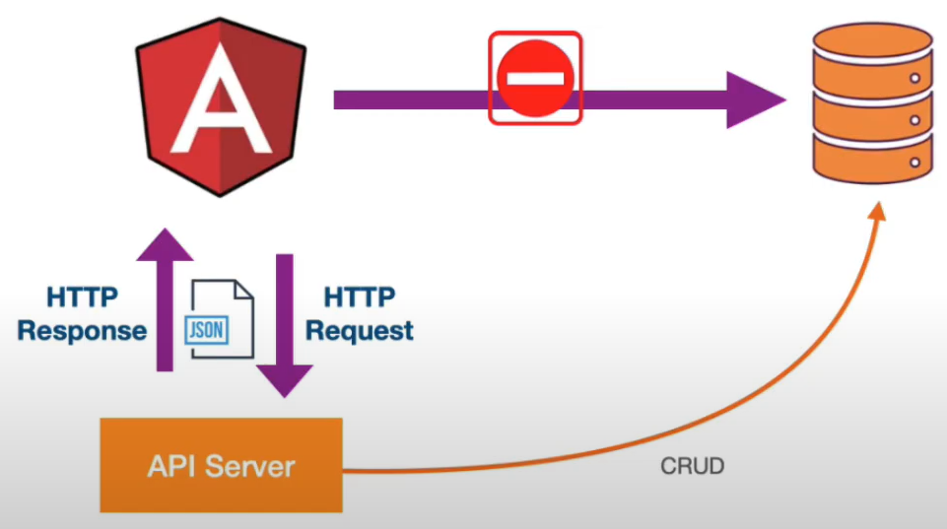
HTTP
How do I connect Angular to a Database ?

Slide 35
HTTP
What is REST(Representational State Transfer) ?
REST is a software architecture style that defines a set of constraints to be used for creating Web services.
Requests made to a resource’s URI will elicit a response with a payload formatted in HTML, XML, JSON, or some other format.
The operations (HTTP methods) available are GET, HEAD, POST……….
透過API去跟server要東西，server可透過多種格式來回應
Applied to Web Servers (RESTful API)
HTTP Verb vs DB Operation
GET : Query Data
POST : New Data
PUT : Update Data
DELETE : Delete Data
透過HTTP Verb去對API Server進行操作
絕對不可以用Chrome來測API！！！

Slide 36
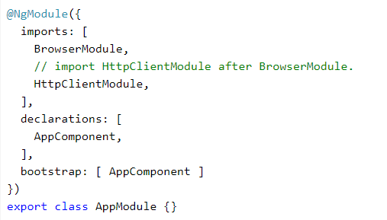
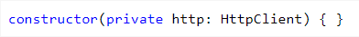
HTTP
How to use HTTP?
匯入 HttpClientModule 模組(app.module.ts)
注入 HttpClient 到 component or service 中
在 Angular 使用 HttpClient 的各種 TypeScript 地雷與陷阱

Slide 37
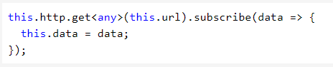
HTTP
How to use HTTP?
透過HTTP POST/GET等串接後端API
把res資料整理成前端想要的樣子
在html檔傳接資料
透過subscribe傳入的 callback 會傳入 JSON 反序列化後的資料
預設

Slide 38
AG-Grid
How to use ag-grid ?

Slide 39
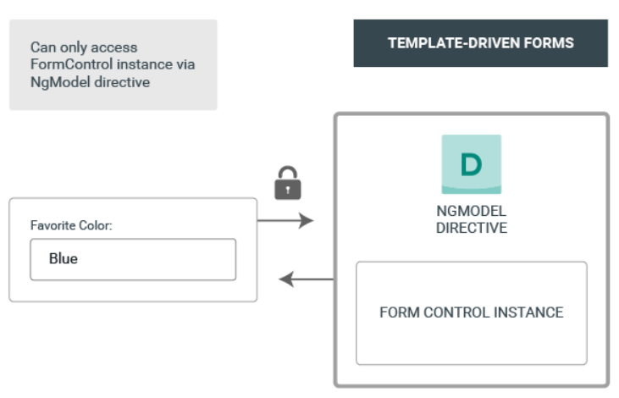
Template-driven forms
What is Template-driven forms?
They are useful for adding a simple form to an app. They’re easy to add to an app, but they don’t scale as well as reactive forms. If you have very basic form requirements and logic that can be managed solely in the template, template-driven forms could be a good fit.

Slide 40

Template-driven forms
How to use Template-driven forms?
在app.module.ts裡面宣告我們要使用FormsModule
Notes:
https://ithelp.ithome.com.tw/articles/10195277

Slide 41



Template-driven forms
How to use Template-driven forms?
使用ngModel對input的值與controller裡的變數做雙向繫結

Slide 42


Template-driven forms
How to use Template-driven forms?
Show and hide validation error messages
若要使用表單驗證，需要在input宣告ngModel（不論有沒有做雙向綁定），或者宣告formControlName或formControl，不然無法驗證。
如果要用客製化的訊息去告訴使用者那邊輸入錯誤的話，則可以將ngModel的值輸出成一個模版變數 #name
因此[hidden]="name.valid || name.pristine"的意思就是如果尚未填到該選項或者填入的值是合法的，則不顯示錯誤訊息。

Slide 43

Template-driven forms
How to use Template-driven forms?
使用ngSubmit送出表單
在ngForm裡面，submit的button按下後並不會直接發生任何事，而是會觸發一個ngSubmit的事件，因此需要在form的地方去註冊ngSubmit事件
我們將這個表單ngForm存至heroForm這個變數裡，因此在submit的按鈕可以存取ngForm裡的值來判段這個表單是否已通過驗證

Slide 44

Reactive forms
What is Reactive forms?
Compared to template-driven forms, they are more robust: they’re more scalable, reusable, and testable. If forms are a key part of your application, or you’re already using reactive patterns for building your application, use reactive forms.

Slide 45


Reactive forms
How to use Reactive forms?
Add a FormGroup
首先要新增FormGroup所需使用的類別
然後創建這個Group，並定義裡面的驗證元素
自行定義要有哪些驗證元素，可以很多個
Notes:
https://ithelp.ithome.com.tw/articles/10195280

Slide 46

Reactive forms
How to use Reactive forms?
在template裡面的form裡指定這個form要使用heroForm來做表單驗證，並且在input裡面指定他的formControlName

Slide 47

Reactive forms
What is FormBuilder ?
FormBuilder可以減少我們在創建formGroup時有太多重覆的定義
How to use FormBuilder ?
要使用要先import必要的檔案

Slide 48

Reactive forms
How to use FormBuilder ?
宣告heroForm為FormGroup
在初始化元件時inject FormBuilder
創建form控件時需要另外去呼叫函數createForm，使用注入的FormBuilder來創建formControl
在創建formGroup時，用this.fb.group來宣告這個formGroup裡所有的formControl

Slide 49


Reactive forms
How to use FormBuilder ?
使用驗證器
額外補充：
Validators.pattern → 可以用在驗證電話號碼或email
Validators.minLength(num)、Validators.maxLength(num) → 可以用在驗證密碼長度

Slide 50



Reactive forms
The data model and the form model
以往我們在創建資料類型時是像這樣子的
但是我們在創建formGroup是這樣子的
我們可以直接利用class來創建formControl

